Slide 1
SONARS
Proximity
DR. JESUS-Arturo Escobedo-CABELLO
Displacement Sensors
Position
Distance/Range
SONAR
Notes:
Sonars are one type of range sensors, they can be used to measure the distance to different objects in several environments today we will focus on their operation and working principles.

Slide 2
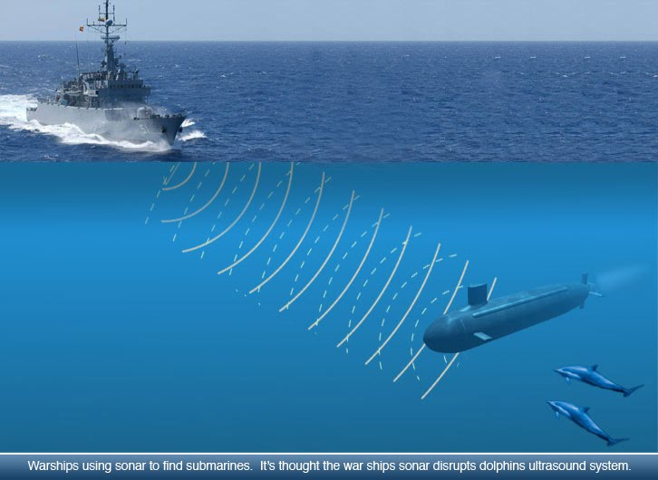
Definition of SONAR
Sonar (Sound Navigation And Ranging)
This term describes a range of sensors that use acoustic signals to measure the distance to objects.
They were created originally to improve ship navigation.
https://sites.google.com/a/acsbr.org/sec-2-lss-physics-2014/home/chapters/4-sound/1-sound-lesson/ultrasound
Notes:
The word SONAR stands for Sound Navigation and Ranging
The knowledge and understanding of underwater sound is not new. Leonardo Da Vinci discovered in 1490 that acoustics propagate well in the ocean: “If you cause your ship to stop and place the head of a long tube in the water and place the outer extremity to your ear, you will hear ships at a great distance from you” The first active sonar designed in the same way modern sonar is, was invented and developed as a direct consequence of the loss of Titanic in 1912, where the basic requirement was to detect icebergs in 2 miles distance.

Slide 3
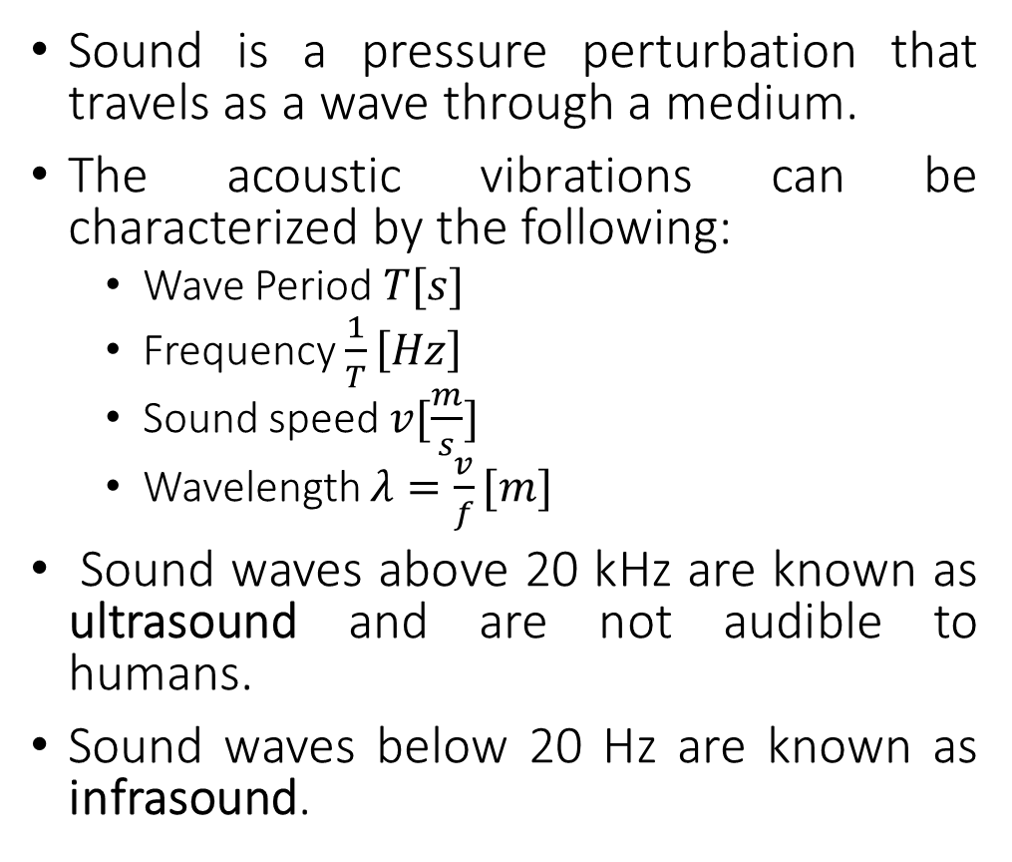
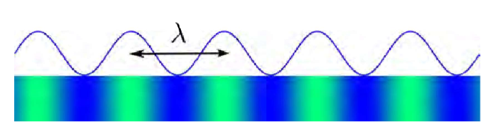
Basic physics
A sound wave is a longitudinal perturbation of pressure
Notes:
Primero recordemos rapidamente algunos datos acerca del sonido que ya todos segurmanete sabemos
El sonido son ondas de presión que se transmiten a través de un mediocomo puede se rel agua, el aire etc
Dichas vibraciones acústicas se caracterizan por los parámetros de Periodo, Frecuencia, velocidad y longitude de onda.

Slide 4
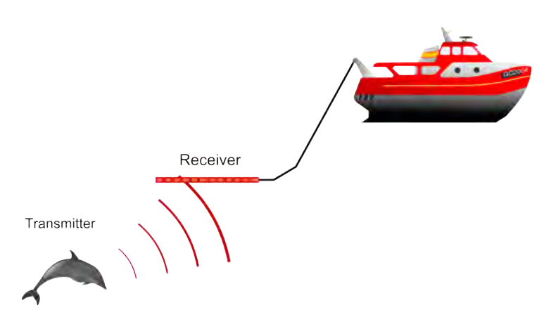
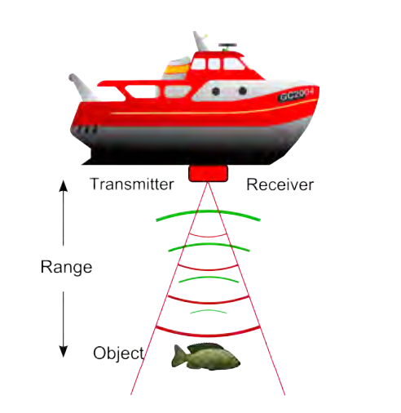
Types of SONAR
There are two different operational modes for sonar:
Passive sonar, where an acoustic noise source is radiated by the target, and the sonar only receives the acoustic signals.
Active sonar, where the sonar itself transmits an acoustic signal, which again propagates to a reflector (or target), which again reflects the signal back to the sonar receiver.
Ultrasonic sensor
Notes:
There are two different operational modes for sonar:
Passive sonar, where an acoustic noise source is radiated by the target, and the sonar only receives the acoustic signals.
Active sonar, where the sonar itself transmits an acoustic signal, which again propagates to a reflector (or target), which again reflects the signal back to the sonar receiver.
Y realmente en el curso nos enfocaremos a u

Slide 5
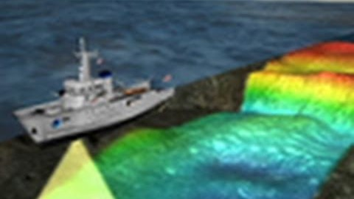
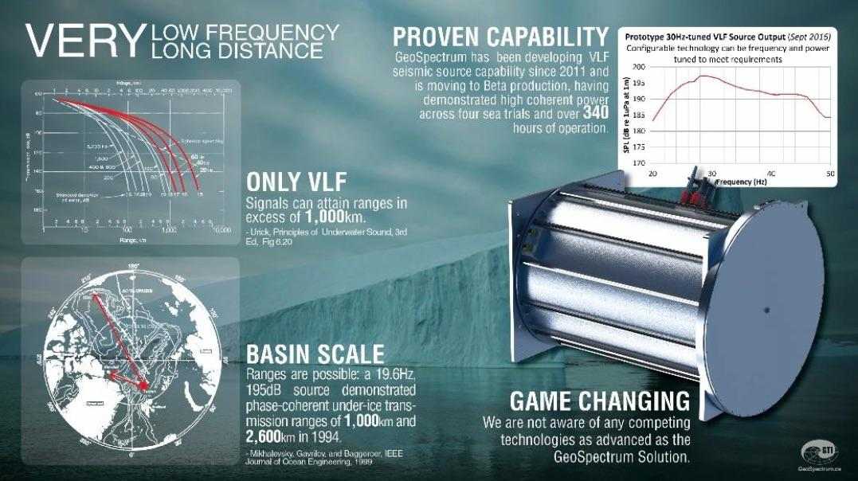
Application of SONARS
https://www.youtube.com/watch?time_continue=87&v=-fAAxEIFeLU: Scientists "See" Ocean Floor via Sonar | National Geographic
https://nunatsiaq.com/stories/article/65674canadian_military_seeks_underwater_sensors_for_arctic_surveillance/
Notes:
190305
No confundir sonar con ultrasónico e ultrasónico es un subgrupo de los sonares. (
----
The word SONAR stands for Sound Navigation and Ranging and it considers a set of devices that emit an ultrasonic signal (greater than 20khz) which travels through the air until it is reflected by some obstacle in its trajectory. The reflected signal is captured by the Sensor. The time that passes between the emission of the ultrasonic signal and the perception of the reflected signal is proportional to the distance to the Object.

Slide 6
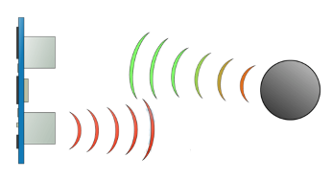
Ultrasonic sensor
They are a special case of SONAR sensors.
They generate an ultrasonic signal (frequency is higher than 20khz) which travels through the air until it is reflected by some obstacle along its trajectory. The reflected signal is captured by a receiver sensor. The time that passes between the emission of the ultrasonic signal and the perception of the reflected signal is proportional to the distance to the object.
From: http://howtomechatronics.com/tutorials/arduino/ultrasonic-sensor-hc-sr04/
Notes:
190305
No confundir sonar con ultrasónico e ultrasónico es un subgrupo de los sonares que son ultrasónicos.
----
The word SONAR stands for Sound Navigation and Ranging and it considers a set of devices that emit an ultrasonic signal (greater than 20khz) which travels through the air until it is reflected by some obstacle in its trajectory. The reflected signal is captured by the Sensor. The time that passes between the emission of the ultrasonic signal and the perception of the reflected signal is proportional to the distance to the Object.

Slide 7
Types of sonars
Low frequency (Infrasonic)
High frequency (Ultrasonic)
Passive: they detect the sound made by objects.
Active they produce pulses
Notes:
Vessel (barco)

Slide 8
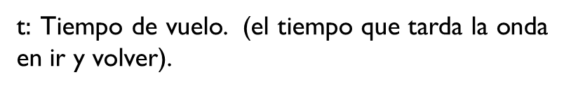


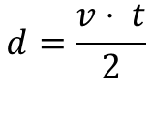
Measuring distance
Given:
As the sound has to travel 2 times the distance 𝑑 in the time 𝑡:
Notes:
Given:
𝑣: Speed of sound in the measuring medium.
𝑑: Distance to the Obstacle.
t: Flight Time. (the time it takes the wave to go and return).
As the sound has to travel 2 times the distance 𝑑 in the time 𝑡:
2𝑑=𝑣⋅ 𝑡
𝑑=(𝑣⋅ 𝑡)/2

Slide 9
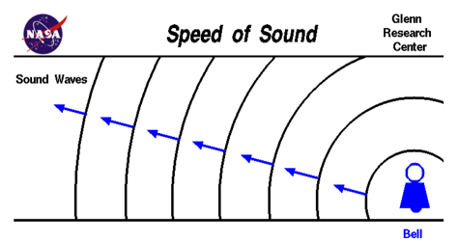

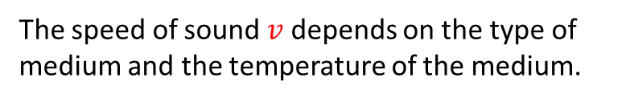


Speed of sound
https://www.grc.nasa.gov/www/k-12/airplane/sound.html
To measure the distance we have to consider the speed of sound in air.
Air temperature | Speed of sound
0°C | 331 m/s
20 °C | 343 m/s
24 °C | 345 m/s
Many engineering applications consider the speed of sound in the earth's atmosphere at room temperature = 346 m/s
Notes:
The speed of sound depends on the medium and the temperature of that medium.
Here we have an expression that allows us to compute the speed of sound in a given medium.
STP Standard temperatura and Pressure

Slide 10
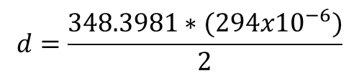







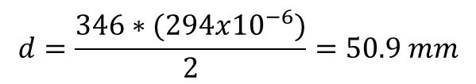
Problem:
What is the distance in [cm] to an obstacle detected using a sonar? If the ambient temperature is 30 °C and the sonar measures a time of flight t = 294 𝜇𝑆?
Notes:
From previous slide we know that the velocity of sound at a given temperature is given by
𝑣=√(𝛾∗𝑅∗𝑇)
Gamma= ratio of specific heat
R=gas constant
T =is the absolute temperature (K) (273.15+°C)

Slide 11
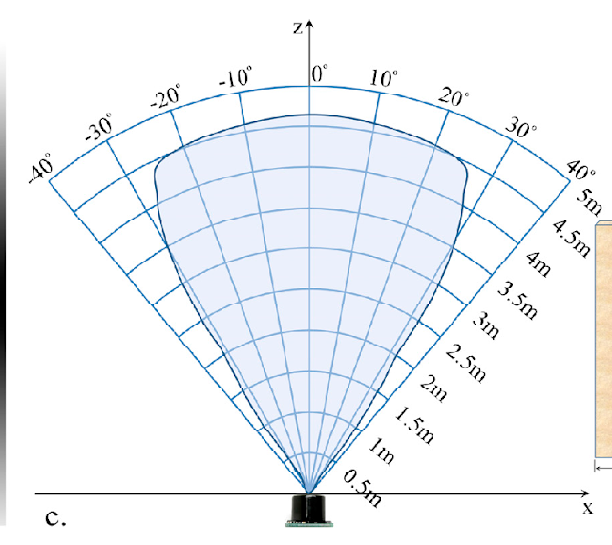
Field of view
A typical sonar has a distinctive directivity pattern that describes its field of view.
Any object within the field of view will be detected and produce an output.
Obj2
Obj1
Sensor output for Obj1 = 3.5 m
Sensor output for Obj2 = 3.5 m
We know the distance to the object but not the angle.
Notes:
A typical sonar has a distinctive directivity pattern that describes its field of view.
Any object within the field of view will be detected and produce an output.

Slide 12








Use for navigation
Typical applications of an ultrasound position sensor for navigation of robots include the use of a sensor ring around the robot or a rotating sensor to determine the safe navigation path.
Obj1
Robot
Sonars
Required direction
Safe direction
Notes:
Typical applications of an ultrasound position sensor for navigation of robots include the use of a sensor ring around the robot or a rotating sensor to determine the safe navigation path.
Entonces digamos que queremos que el robot se mueva en una direccón determinada.
Nos centraremos en lo que verían nuestros sensores en esa dirección (CLIK) y supongamos que hay un objeto.
La rutina de navegación de nuestro robot (de forma muy sencilla) tendría que hacer mover mi robot en la dirección mas cercana que po

Slide 13
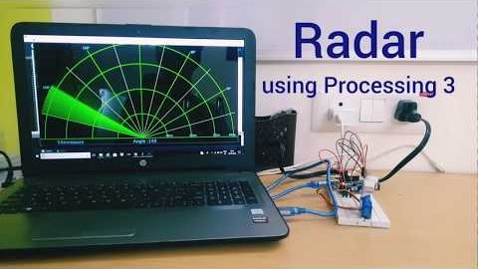
Use for navigation
Typical applications of an ultrasound position sensor for navigation of robots include the use of a sensor ring around the robot or a rotating sensor to determine the angle for different objects.

Slide 15
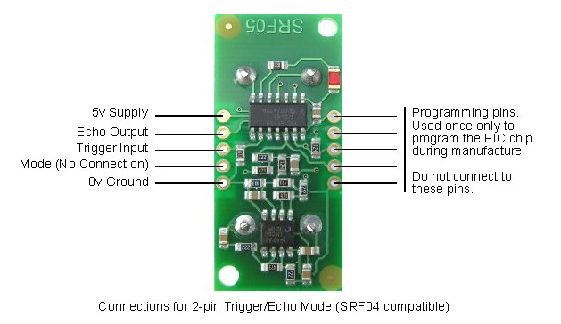
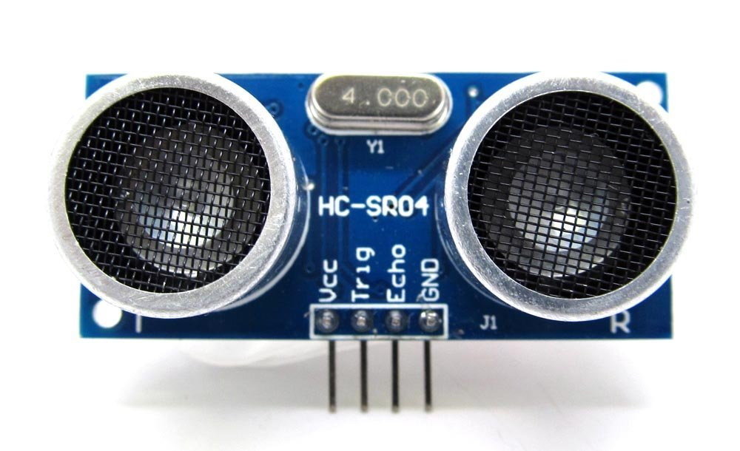
SRF04 and 05
The SRF04 has 4 terminals.
Vcc
Trig
Echo
Ground
The SRF05 has 5 terminals.
Mode:
HIGH => Separate Trigger and Echo
LOW => Single Trigger and Echo PIN
https://www.robot-electronics.co.uk/htm/srf05tech.htm
Notes:
The srf04 and 05 are cheap sonar sensors that we will be using the next class. They have the typical components of any ultrasonic sensor.
For example the SRF04 has 4 terminals

Slide 16
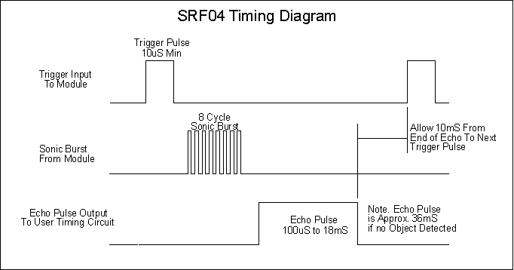
Operation SRF 04/05
A minimum pulse of 10 𝜇𝑆 is applied in the SRF04/05 TRIGGER. The sensor sends an 8-PULSE signal at a frequency of 40 kHz (ultrasonic). At the same time the ECHO pin will be high. The sensor will wait to detect the echo of the signal sent and as soon as it detects it puts the output echo in low again.
The ECHO output generates a pulse whose width is proportional to the Object's distance. If the sensor does not detect an echo, then the pulse width in echo will be 36mS.
Notes:
A minimum pulse of 10 𝜇𝑆 is applied in the SRF04/05 TRIGGER.
Se aplica un pulso mínimo de 10𝜇𝑆 en el TRIGGER del SRF04/05.
The sensor sends an 8-PULSE signal at a frequency of 40 kHz (ultrasonic). At the same time the ECHO pin will be high. The sensor will wait to detect the echo of the signal sent and as soon as it detects it puts the output echo in low again.
The ECHO output generates a pulse whose width is proportional to the Object's distance. If the sensor does not detect an echo, then the pulse width in echo will be 36mS.

Slide 17
Operation SRF 04/05 (2)
The sensor can take a new measurement approximately every 50mS, or 20 times per second. Note, a minimum of 50 mS should be expected before the next trigger pulse is sent, even if the SRF04 detects a nearby object and the ECHO pulse is shorter. (this is for the purpose of ensuring that the pulse train disappears and does not produce errors in the next measurement).

